Slide 1
Geodesic Domes math 8 Project Based Learning Unit created by S. Harvey and supported by M. Crompton Dunsmuir Middle School 2014

Slide 2
Table of Contents
Background Info
Definition
History
Comparison - Complexity
Domes in the Real World
Architecture - Buildings
Around the World
Cultural Representations
Practical Applications

Slide 3
Background Info
A geodesic dome is a partial-spherical shell structure based on a network of great circles (geodesics) on the surface of a sphere.
The geodesics intersect to form triangular elements that are rigid and distribute the stress across the structure.

Slide 4
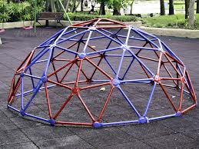
Background Info
The geodesic shape is extremely strong for its weight.
The surface has a stable structure.
The sphere encloses the greatest volume for the least surface area.

Slide 5
Definition
A light, domelike structure developed by R. Buckminster Fuller to combine the properties of the tetrahedron and the sphere and consists of a grid of compression or tension members lying upon or parallel to great circles running in three directions in any given area, the typical form being the projection upon a sphere of an icosahedron, the triangular faces of which are filled with a symmetrical triangular, hexagonal, or quadrangular grid. (Dictionary.com)
The lightest, strongest, and most cost-effective structure ever devised. The geodesic dome is able to cover more space without internal supports than any other enclosure.

Slide 6
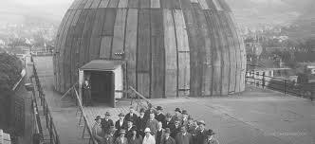
History
The first dome was designed after World War I by Walther Bauersfeld.
He was an engineer at Zeiss optical company.
The dome was created to house his planetarium projector.
The dome was patented and constructed on the roof of the Zeiss plant in Jena, Germany.
It opened in 1926.

Slide 7
Comparison - Complexity
Geodesic domes are comprised of a network of triangles that form a somewhat spherical surface.
The more complex the network of triangles, the more spherical the geodesic dome and the higher the class number.
A 2V geodesic dome is comprised of only two different sized triangles.
A 3V dome is comprised of three triangle sizes.
The 4V dome is made of 6 triangle sizes.

Slide 8
Domes in the Real World
The practical side of where dome shapes can be found in your every day lives.
They can be made from many different materials.
They can be found in Architecture as well as many other places.

Slide 9
Architecture Buildings Close to Home
BC Parliament Buildings
Victoria
Observatory
Victoria

Slide 10
Architecture Around the World
India
Europe

Slide 11
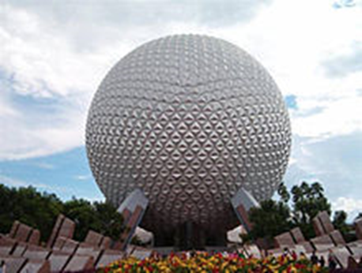
Architecture Businesses
Science World Vancouver
Disney’s Epcot Centre

Slide 12
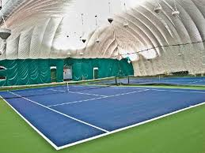
Architecture Sports
Indoor Tennis Court
Stadium

Slide 13
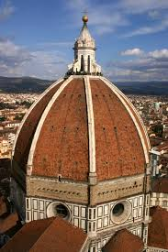
Culture - Religion
Cathedral
Mosque

Slide 14
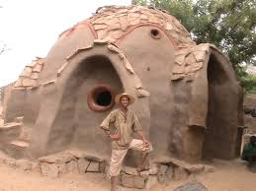
Homes – Hot & Cold

Slide 15
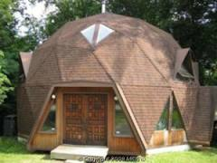
Homes

Slide 16
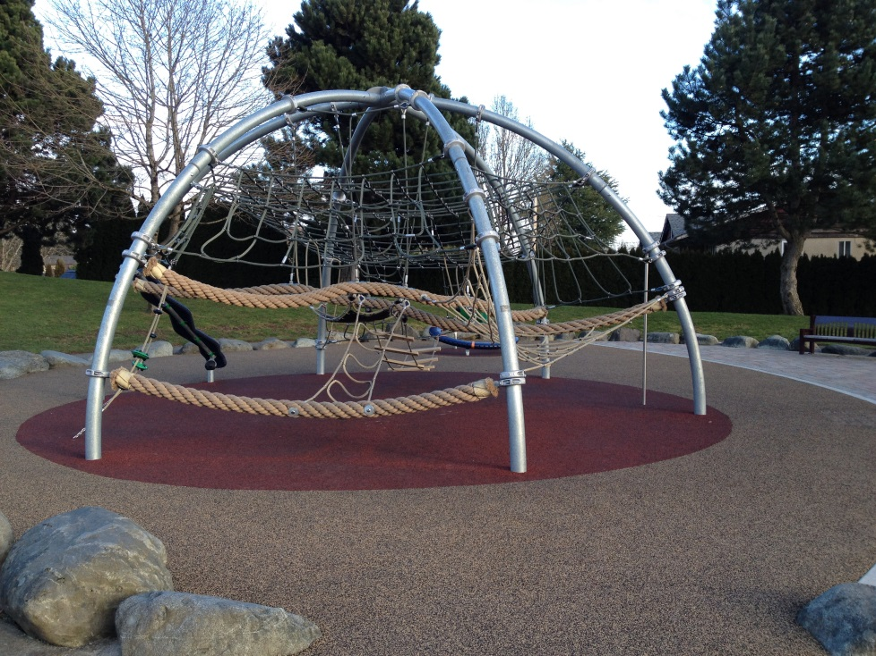
Playground

Slide 17
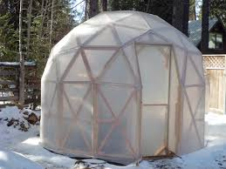
Greenhouses

Slide 18
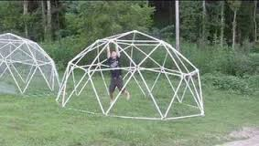
Strength of Domes
Geodesic Dome Strength

Slide 19
Dome Shapes - Everywhere

Slide 20
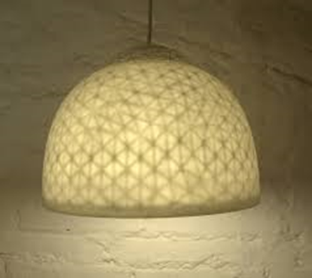
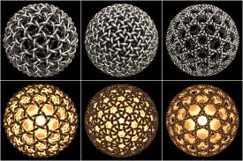
Art - Lamps

Slide 21
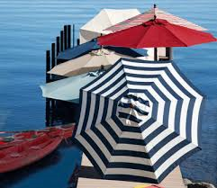
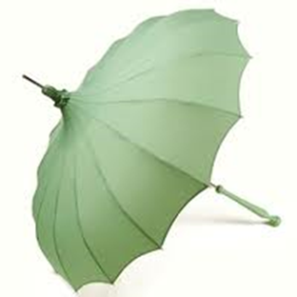
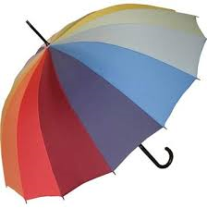
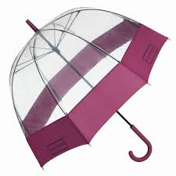
Umbrellas

Slide 22
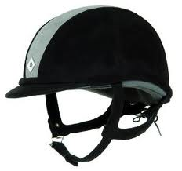
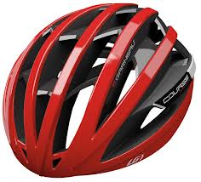
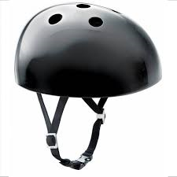
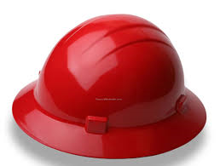
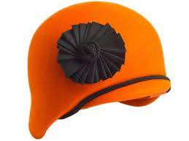
Hats of All Shapes & Sizes

Slide 23
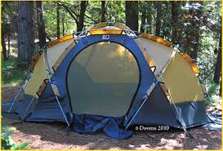
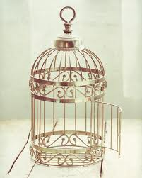
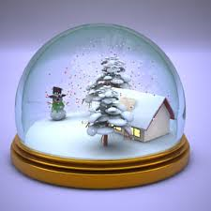
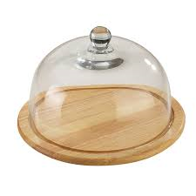
Practical or fun?

Slide 24
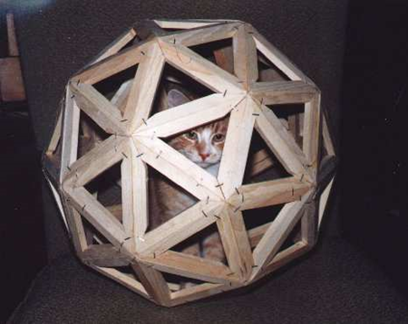
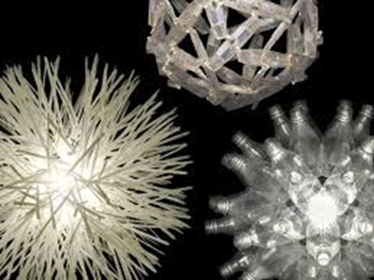
Materials
Can be made out of any material:
Glass
Metal
Wood
Plastic
Stone
Mud
Paper
Etc.

Slide 25
How You Can Do It

Slide 26
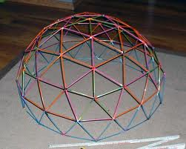
What You Can Do

Slide 27
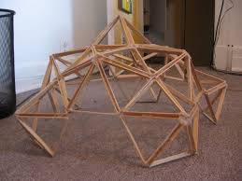
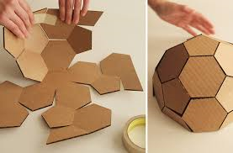
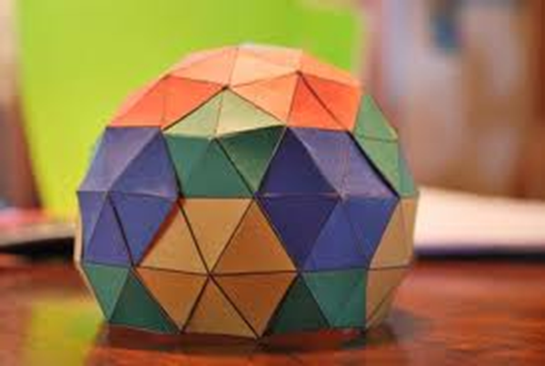
The Possibilities are Endless

Slide 28
Bibliography
By Example: The Quest for Sustainable Living. c. 2013 http://www.byexample.net/library/illustrations/geodesic_dome_formula/
Dictionary.com – Geodesic Dome. C. 2014 http://dictionary.reference.com/browse/geodesic+dome?s=t
Geodesic Domes. C.2013. Cyberian Frontier. http://en.wikipedia.org/wiki/Geodesic_dome
The Great Info Finder: Geodesic Dome. C.2007. http://www.ideafinder.com/history/inventions/geodesicdome.htm

Slide 29
Bibliography - Images
Playground - http://www.loupiote.com/photos/3908692769.shtml
Paper dome - http://sci-toys.com/scitoys/scitoys/mathematics/dome/paper_dome/three_domes.jpg
Straw dome - http://anthony.liekens.net/images/dome1.jpg
Historical - http://nyogalleristny.files.wordpress.com/2011/11/fuller.jpg
Science World - http://cdn.tourbytransit.com/vancouver/images/Telus-World-of-Science.jpg
Observatory - http://www.birdsofafeather.ca/sites/default/files/styles/medium/public/images/thingstodo/plaskett-telescope.gif
Buildings - http://www.biblewalks.com/Photos54/DomeRock9.jpg
Homes - http://www.naturalspacesdomes.com/images/domes_for_sale/db_images/PLUMAS200700975_image.jpg
Stained Glass - http://nwn.blogs.com/photos/uncategorized/geodesic_dome_by_cpage.jpg
Stadium Frame - http://estoprelims.com/blog/wp-content/uploads/2011/09/JG-dome.jpg
Greenhouse - http://growingdomegreenhousesbydavid.blogspot.ca/2012/03/why-geodesic-dome-by-david.html
Taj Mahal - http://upload.wikimedia.org/wikipedia/commons/f/f5/Taj_Mahal_2012.jpg
Mud Home - http://www.livingearthstructures.com/sites/default/files/images/image-gallery/10/Dogon%20Dome%20-%20Copy.JPG
Geodesic Dome - http://3.s3.envato.com/files/35886228/P1017411ps.jpg

Slide 30
Bibliography – Images Con’t
Igloo - http://www.alaska-in-pictures.com/inupiat-eskimo-igloo-438-pictures.htm
Comparison domes - http://www.byexample.net/library/illustrations/geodesic_dome_formula/
Tennis - http://g-ecx.images-amazon.com/images/G/01/ember/deals/3e9be9085bcd6dcba6c8ebef92c877054f84971388a94b8145b535f348cbc3d8
Paper Lamp - http://cunicode.com/site/wp-content/uploads/2011/09/Stellate-Pendant-Light-002.jpg
Birdcage - http://thumbs.dreamstime.com/z/bird-cage-1283457.jpg
Snowglobe - http://previewcf.turbosquid.com/Preview/2010/12/05__05_00_00/Christmas_snowglobe0020.png6836c131-83a0-4a68-9ec9-762149116f31Larger.jpg
Tent - http://www.oregonphotos.com/Resources/NF-Pole-Sleeve-Deems.jpg

Slide 31
Bibliography – Images Con’t
Umbrella - http://4.bp.blogspot.com/_n1Jgy6WlY9E/TLdTA5xz61I/AAAAAAAALvA/db7rVTg2WgY/s1600/bella%2Bumbrella.jpg
Cat - http://www.sentex.net/~mwandel/built/geodesics.html
Rainbow Umbrella - http://www.raindropsto.com/media/catalog/product/cache/1/image/9df78eab33525d08d6e5fb8d27136e95/a/d/adult-fulton-full-length-soho-rainbow-umbrella.jpg
Popsicle Sticks - http://cdn.instructables.com/F2Q/YP3J/G0IPADB7/F2QYP3JG0IPADB7.LARGE.jpg
Hats - http://www.designerwholesalesources.com/images/discount-rocky-hats-3.jpg
Geodesic Dome Cutout - http://scoutregalia.com/images/project/GEODESIC-GINGERBREAD-03.jpg

